Slide 1
Assessment of Impacts of Microfinance
Challenges and Methods

Slide 2
Challenges
Multiplicity of social and economic outcomes besides income
Need to deal with both selection and reverse causation
Difficulty of examining the counterfactual: what would have happened w/o microfinance
Participants are not randomly selected but self select because of foreseen benefits. But others may be excluded for social reasons such as preserving modesty of women
The many dimensions of microfinance which make it difficult to tell which are most important

Slide 3
Tradeoffs in Benefits
More income from woman’s business may imply less time in raising children and the benefits thereof. Which is more important?
Effects on raising woman’s bargaining power within hh.
Training and education aspects of microfinance may have benefits separate from those of credit per se. Smith (2002) showed that programs in Honduras and Ecuador with health training had extra benefits w/o loss in terms of credit effects relative to programs with credit only.

Slide 4
Need for controls
Personal characteristics: Education, age, health, but other skills like entrepreneurship, managerial skills may be harder to control for. Also health shocks
Location, city or urban but dynamics of growth there rarely controlled for. Collective shocks to village, political trouble, floods
But participation in scheme may depend on many of these same characteristics

Slide 5
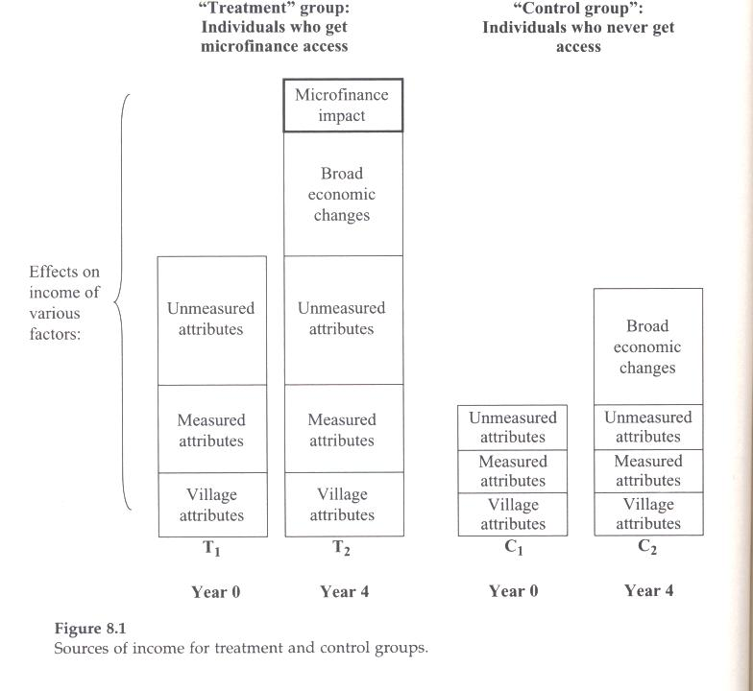

Slide 6
Methods of Evaluation
T2-T1 comparisons do not account for the changes in individual, hh and village conditions.
By identifying a control group C and
  T2-C2 but doesn’t take into account their different starting positions
netting out (T2-T1)-(C2-C1) This is the difference-in-difference approach

Slide 7
Limitations of “diff n diff”
Some attributes may be changing over time
There may have been pre-period 1 trends in income or other characteristics that were different between T and C
Due to self selection T and C may differ in ways that relate to potential program benefits. Many such attributes unobservable

Slide 8
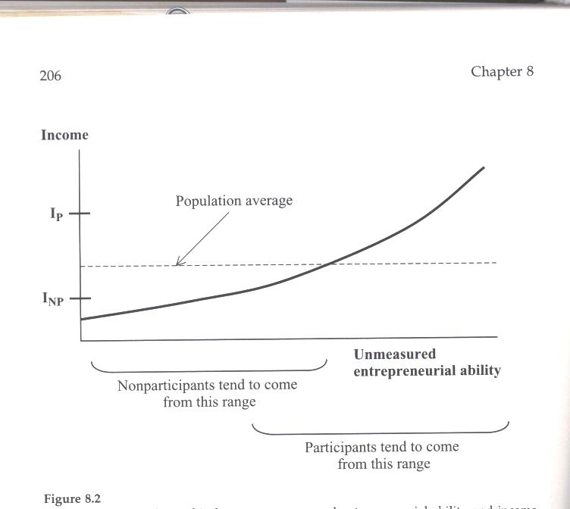

Slide 9
Suppose we take another identical village w/o program
But even here it is not comparable because there was no selection in the second village
What to do?

Slide 10
Solution 1: Change the question:
Compare the effect of access to the program and lack of access
But in this case there is still the problem of lack of randomness in program placement

Slide 11
Solution 2: Matching Scores
Try to identify people in the non-program village who would be likely to self-select into the program
Coleman 1999,2002 study of NE Thailand
445 hhs in 14 villages, 8 with village banks, 6 w/o village banks in 1995 but the latter had begun to get ready and hence people has self-selected in according to the standard rules. But then program delayed 1 year

Slide 12
Regression Model
Y_{ij} = X_{ij}α+ V_{j}β +M_{ij}γ +T_{ij}δ +η_{ij}
i is hh, j is village, Y is outcome, X are hh characteristics, V are village dummies, M is dummy for actual or potential members, T is no of months actual program has been available

Slide 13
Findings
No significant impact of program on average
But when extended to distinguish between rank and file members and the generally richer members of the village bank committee (who also know the system better), the latter were shown to have significant improvements

Slide 14
Why might the effects be so small?
Loans very small, too small to have noticeable impacts in short period of time
There were other alternative sources in villages (quite unlike Bangladesh at the time that Grameen started)

Slide 15
Method of comparing new borrowers with old borrowers
Possible selection problem in which ones came first.
Dropouts occur and there may be selectivity in this
Evidence that dropout rates are often quite high (Wright 2001, Khandker 2003
The impacts of program may affect the dropout rate
Karlin suggested modeling dropout rate from older borrowers and then predicting dropouts among the younger workers, use the prediction to weigh the new borrower control group

Slide 16
AIMS studies in India, Peru and Zimbabwe from USAID
Care taken to follow dropouts and to get suitable control groups. They did not take full advantage of differencing:
Y_{ijt} = X_{ijt}α+ V_{j}β +M_{ij}γ +T_{ijt}δ +η_{ijt} (1)
Where Y represents income or profits, with V_{j},M_{ij} assumed to be non-changing
Write this again for t+1 and then take the first difference between them
∆Y_{ij} =∆X_{ij} α +∆T_{ij} δ +∆ η_{ij} (2)

Slide 17
Problems
V_{j} and M_{ij} may in fact change over time
Some of these factors, moreover may be unobservable
By working with changes the bias (downward due to measurement error) may increase
But big advantage is that estimates of δ (i.e., impacts of the loans on profits) are consistent
Estimated effects fall when the RHS variable is instrumented

Slide 18
Quasi-experimental Method
Get good instrument for microfinance participation
Some examples: interest rate (a measure of how much credit individual might want but with no effect on profit?). But these seldom vary within a program. Lender characteristics, but if only one, this will have no variation.
What did Khandker 1998, 2003 do?

Slide 19
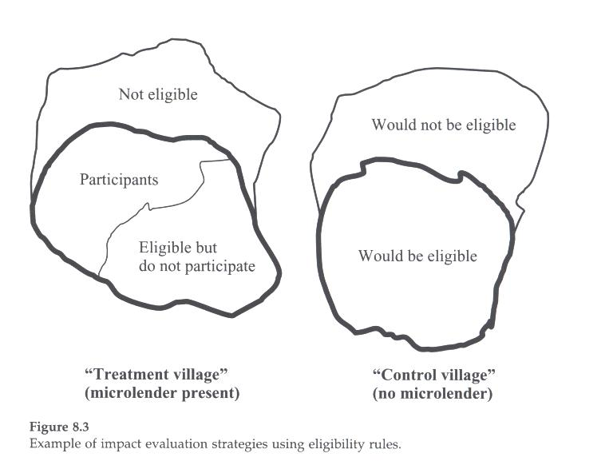
Narrowing the focus in Treatment and Control Villages

Slide 20
Comparing participants with eligible but non-participating
Assume no spillovers from participants to eligible but not participating.
Program placement is not likely to be random: Pitt and Khandker (1998): Grameen Bank, BRAC and state-run RD12 have same eligibility rule (<.5 acres of land)
Could do “diff n diff”

Slide 21
Double “diff n diff”
Y_{ij} = X_{ij}α+ V_{j}β +E_{ij}γ +T_{ij} E_{ij} δ’ +η_{ij}
E indicates whether or not eligible
Interaction terms TE to compare impacts between timing and elegibility
Morduch 1998 uses this method to show no evidence of effect of MF on hh consumption but that income is less variable across seasons.
Eligibility must be exogenous, not an objective where in people might sell land to become eligible. They cite absence of land market since most determined by inheritance.

Slide 22
Khandker 2003 shows that rules for eligibility in terms of landholding size were not strictly adhered to.
But Pitt and Khandker 1998 show that results are robust to this specification
But they also expand the list of instruments by including interactions with hh characteristics, X_{ij} T_{ij} E_{ij}
Assume that education and demographic variables affect outcomes in same way for whole sample
Assume (1) Tobit equation for instrumenting participation (credit demand), (2) that microfinance effects are the same across all borrowers and (3) that the marginal and ave. impacts are the same

Slide 23
Pitt and Khandker distinguish between male and females in credit impacts based on 1991-92 data: Results
Shows that hh consumption rises by 18 taka for every 100 taka lent to a woman but only 11 per 100 taka to a man.
They attribute this to men taking more leisure
Nonland assets increase from female borrowing but not by men. Schooling of girls rises only in case of women borrowing from Grameen Bank.

Slide 24
Khandker (2003) estimates eq. (2) with panel formed by 1991-2, 1998-9
Problems:
  Mistargeting became more severe
  Program had spread to all villages
Findings
1. in area with program in 1991-2 poverty declined just as much by 1998-9 for participants as for eligible non-participants
Why? Doesn’t matter? Or spillovers?
2 In villages with no program in 1991-2, effects on poverty reductions similar, except they are smaller among eligible non-participants

Slide 25
Randomized experiments: Advantage and Problems
Advantage: Exogenous treatment
Problems:
With slow development (little lending for a while) samples would have to be very large to detect outcomes
Ethical problem: excluding deserving people from the program
How to prevent members of control group from getting access to other sources of credit during the evaluation period. This bleeding of control group may lead to downward bias.

Slide 26
Hence Randomized experiments may have to be for short term only.
This brings additional problems
May involve a dynamic self-selection problem: who are the first?
The effects may take longer to be realized, hence effects underestimated
Short term trials may suffer from influence of seasonal shocks, esp. in agriculture
May miss opportunity to study dynamic effects over time

Slide 27
McIntosh and Wydick (2007)
Make use of retrospective information to detect previous trends in control and treatment communities and participants and non-participants.

